Slide 1
Application Architecture
James Chambers| Senior Software Developer
Simon Timms| Senior Software Developer

Slide 2
Course Topics
Applications on Azure: Putting the Pieces Together
01 | Introduction | 05 | Azure Storage
02 | Application Architecture | 06 | Docker and Log Management
03 | DNS | 07 | AutoScale
04 | Batch | 08 | Review and Summary

Slide 3
Course Topics
Applications on Azure: Putting the Pieces Together
01 | Introduction | 05 | Azure Storage
02 | Application Architecture | 06 | Docker and Log Management
03 | DNS | 07 | AutoScale
04 | Batch | 08 | Review and Summary

Slide 4
A trip to the parts bin
Please leave this area blank to allow for picture in picture recording
Monolithic applications are
Tough to maintain
Not very fault tolerant
Difficult to scale

Slide 5
A trip to the parts bin
Please leave this area blank to allow for picture in picture recording
Instead let’s try
Smaller services
Communication using messaging
Fault tolerance

Slide 6
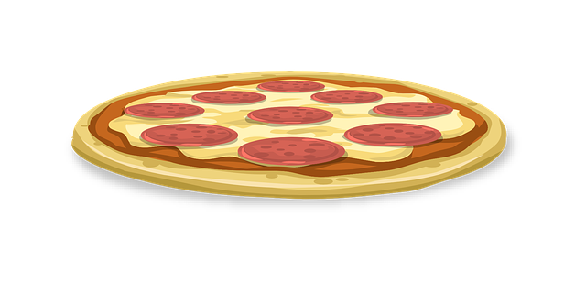
Microservices?
Please leave this area blank to allow for picture in picture recording
Microservices are
Componentized via services
Single purpose
Isolated storage
Resilient to failure
Generally small

Slide 7
Resilient Communication
Please leave this area blank to allow for picture in picture recording
Making use of messaging
Asynchronicity

Slide 8
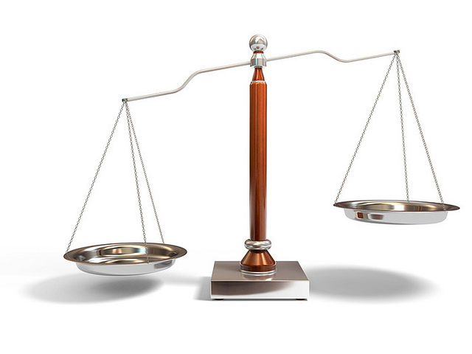
Finding the balance between resilience and ease of programming
Please leave this area blank to allow for picture in picture recording
https://www.flickr.com/photos/61056899@N06/5751301741

Slide 9
Out of process messaging
Please leave this area blank to allow for picture in picture recording
Greater resiliency to failure
Easier to distribute and scale
Can be coupled with CQRS to support multiple
However…
Common UI paradigms don’t work well (add record and show list)
Not all that easy

Slide 10
CQRS?
Please leave this area blank to allow for picture in picture recording
Splitting read and write models
Have multiple read models to facilitate different views of data
Easy to support polyglot persistence
Check out the CQRS Journey https://cqrsjourney.github.io/

Slide 11
Our Building Blocks
Please leave this area blank to allow for picture in picture recording

Slide 12
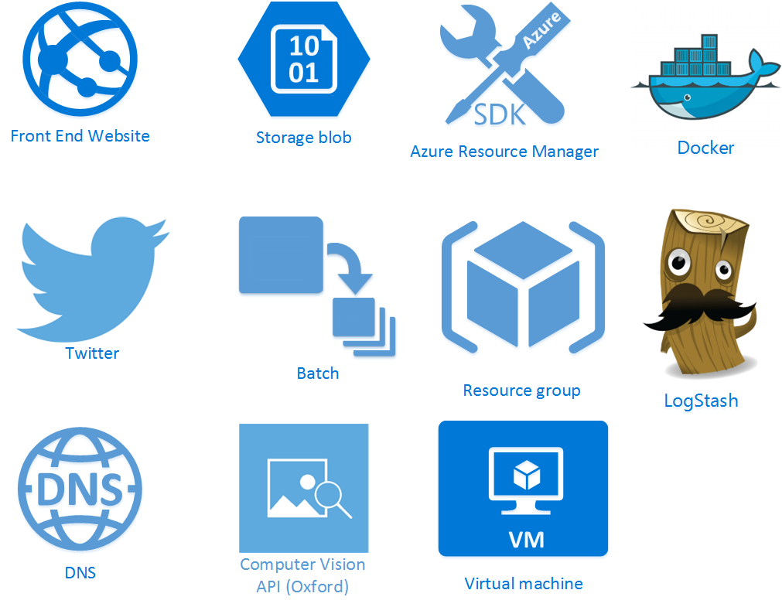
Please leave this area blank to allow for picture in picture recording

Slide 13
Please leave this area blank to allow for picture in picture recording

Slide 14
Please leave this area blank to allow for picture in picture recording

Slide 15
Please leave this area blank to allow for picture in picture recording

Slide 16
Please leave this area blank to allow for picture in picture recording

Slide 17
Please leave this area blank to allow for picture in picture recording

Slide 18
Please leave this area blank to allow for picture in picture recording
Notes:
Drop over to the website and demo how nifty it is that oxford can do things with images

Slide 19
Please leave this area blank to allow for picture in picture recording
Notes:
Json based, can configure most services in a declarative fashion. What does that mean?

Slide 20
Please leave this area blank to allow for picture in picture recording

Slide 21
Please leave this area blank to allow for picture in picture recording

Slide 22
Please leave this area blank to allow for picture in picture recording

Slide 23
Please leave this area blank to allow for picture in picture recording

Slide 24
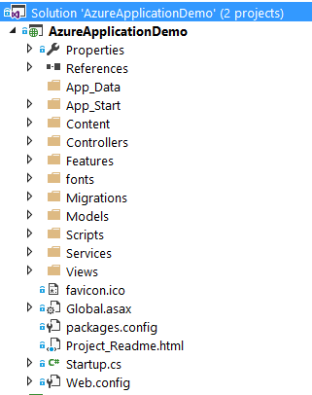
Web Application
Please leave this area blank to allow for picture in picture recording

Slide 25
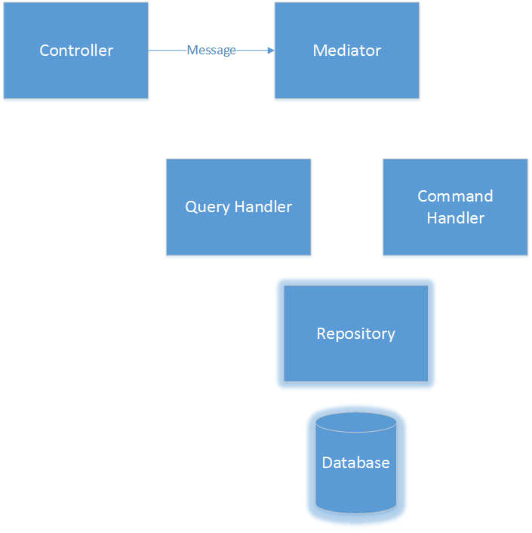
MediatR
Please leave this area blank to allow for picture in picture recording

Slide 26
MediatR
Please leave this area blank to allow for picture in picture recording
Validate

Slide 27

MediatR
Please leave this area blank to allow for picture in picture recording

Slide 28

MediatR
Please leave this area blank to allow for picture in picture recording

Slide 29

MediatR
Please leave this area blank to allow for picture in picture recording

Slide 30
MediatR
Please leave this area blank to allow for picture in picture recording

Slide 31
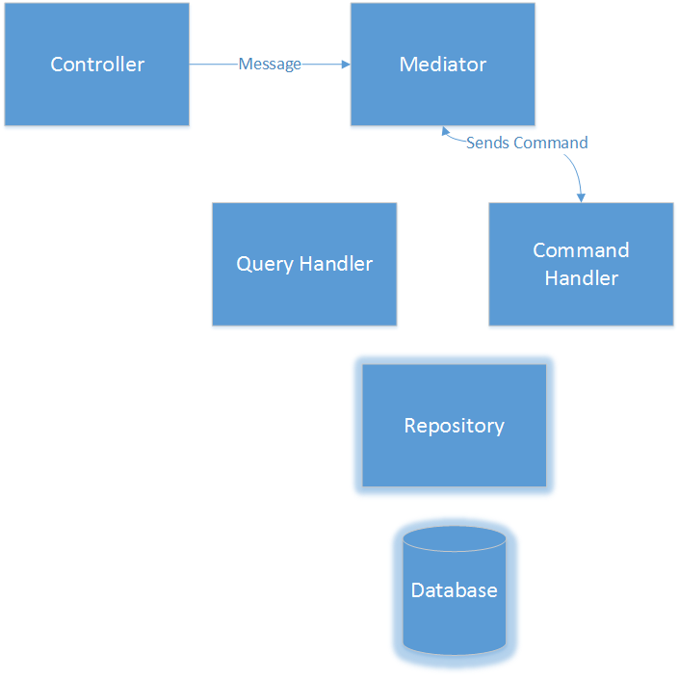
MediatR
Please leave this area blank to allow for picture in picture recording

Slide 32

MediatR
Please leave this area blank to allow for picture in picture recording

Slide 33
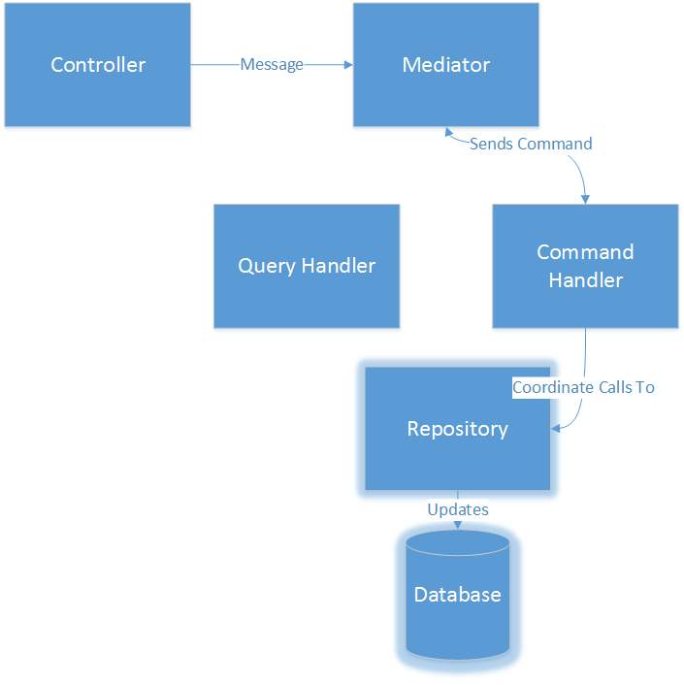
MediatR
Please leave this area blank to allow for picture in picture recording

Slide 34
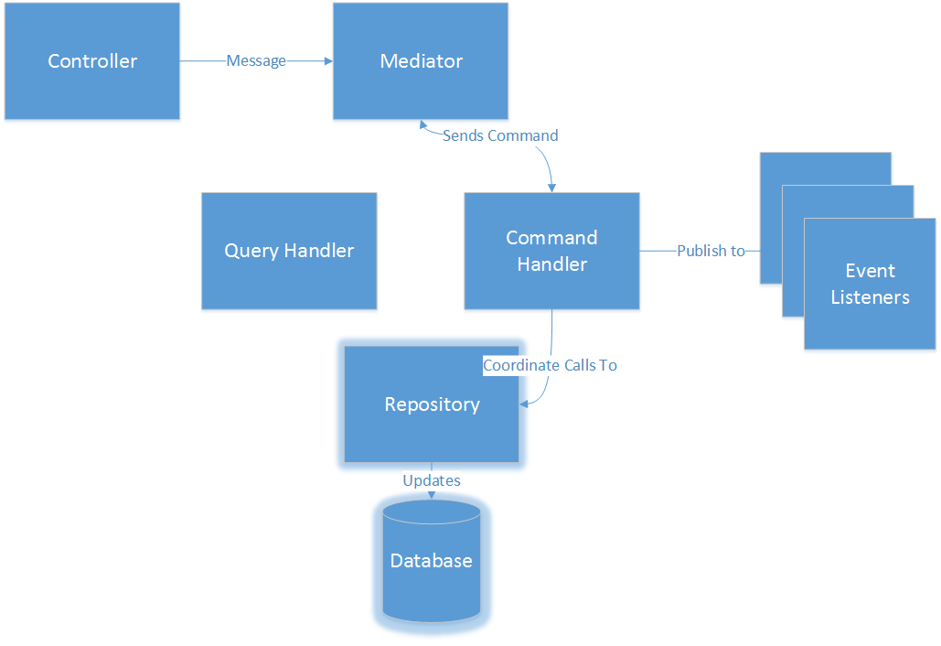
MediatR
Please leave this area blank to allow for picture in picture recording
Notes:
Event listeners perform dependent actions – update other views, publish messages on external busses, notify users

Slide 35
MediatR – How do we arrange code?
Please leave this area blank to allow for picture in picture recording
Notes:
Drop to visual studio

Slide 36


Twitter Authentication
Please leave this area blank to allow for picture in picture recording
http://bmj2k.com/2013/06/21/imponderable-98-lomza-poland/
http://balzanomichele.blogspot.ca/p/password.html
Notes:
There have been a lot of passwords stolen as of late. No matter how good your password security there could be a flaw which will let criminals <space> to steal your passwords or other user details.

Slide 37
Twitter Authentication
Please leave this area blank to allow for picture in picture recording
?
http://bmj2k.com/2013/06/21/imponderable-98-lomza-poland/
Notes:
Instead of storing passwords why don’t we just keep them somewhere else? We can use a service like twitter to do our authentication for us. That way when the criminals come calling there is nothing for them to steal.

